Slide 1
Week1 ideas
Yuejiao Geng

Slide 2
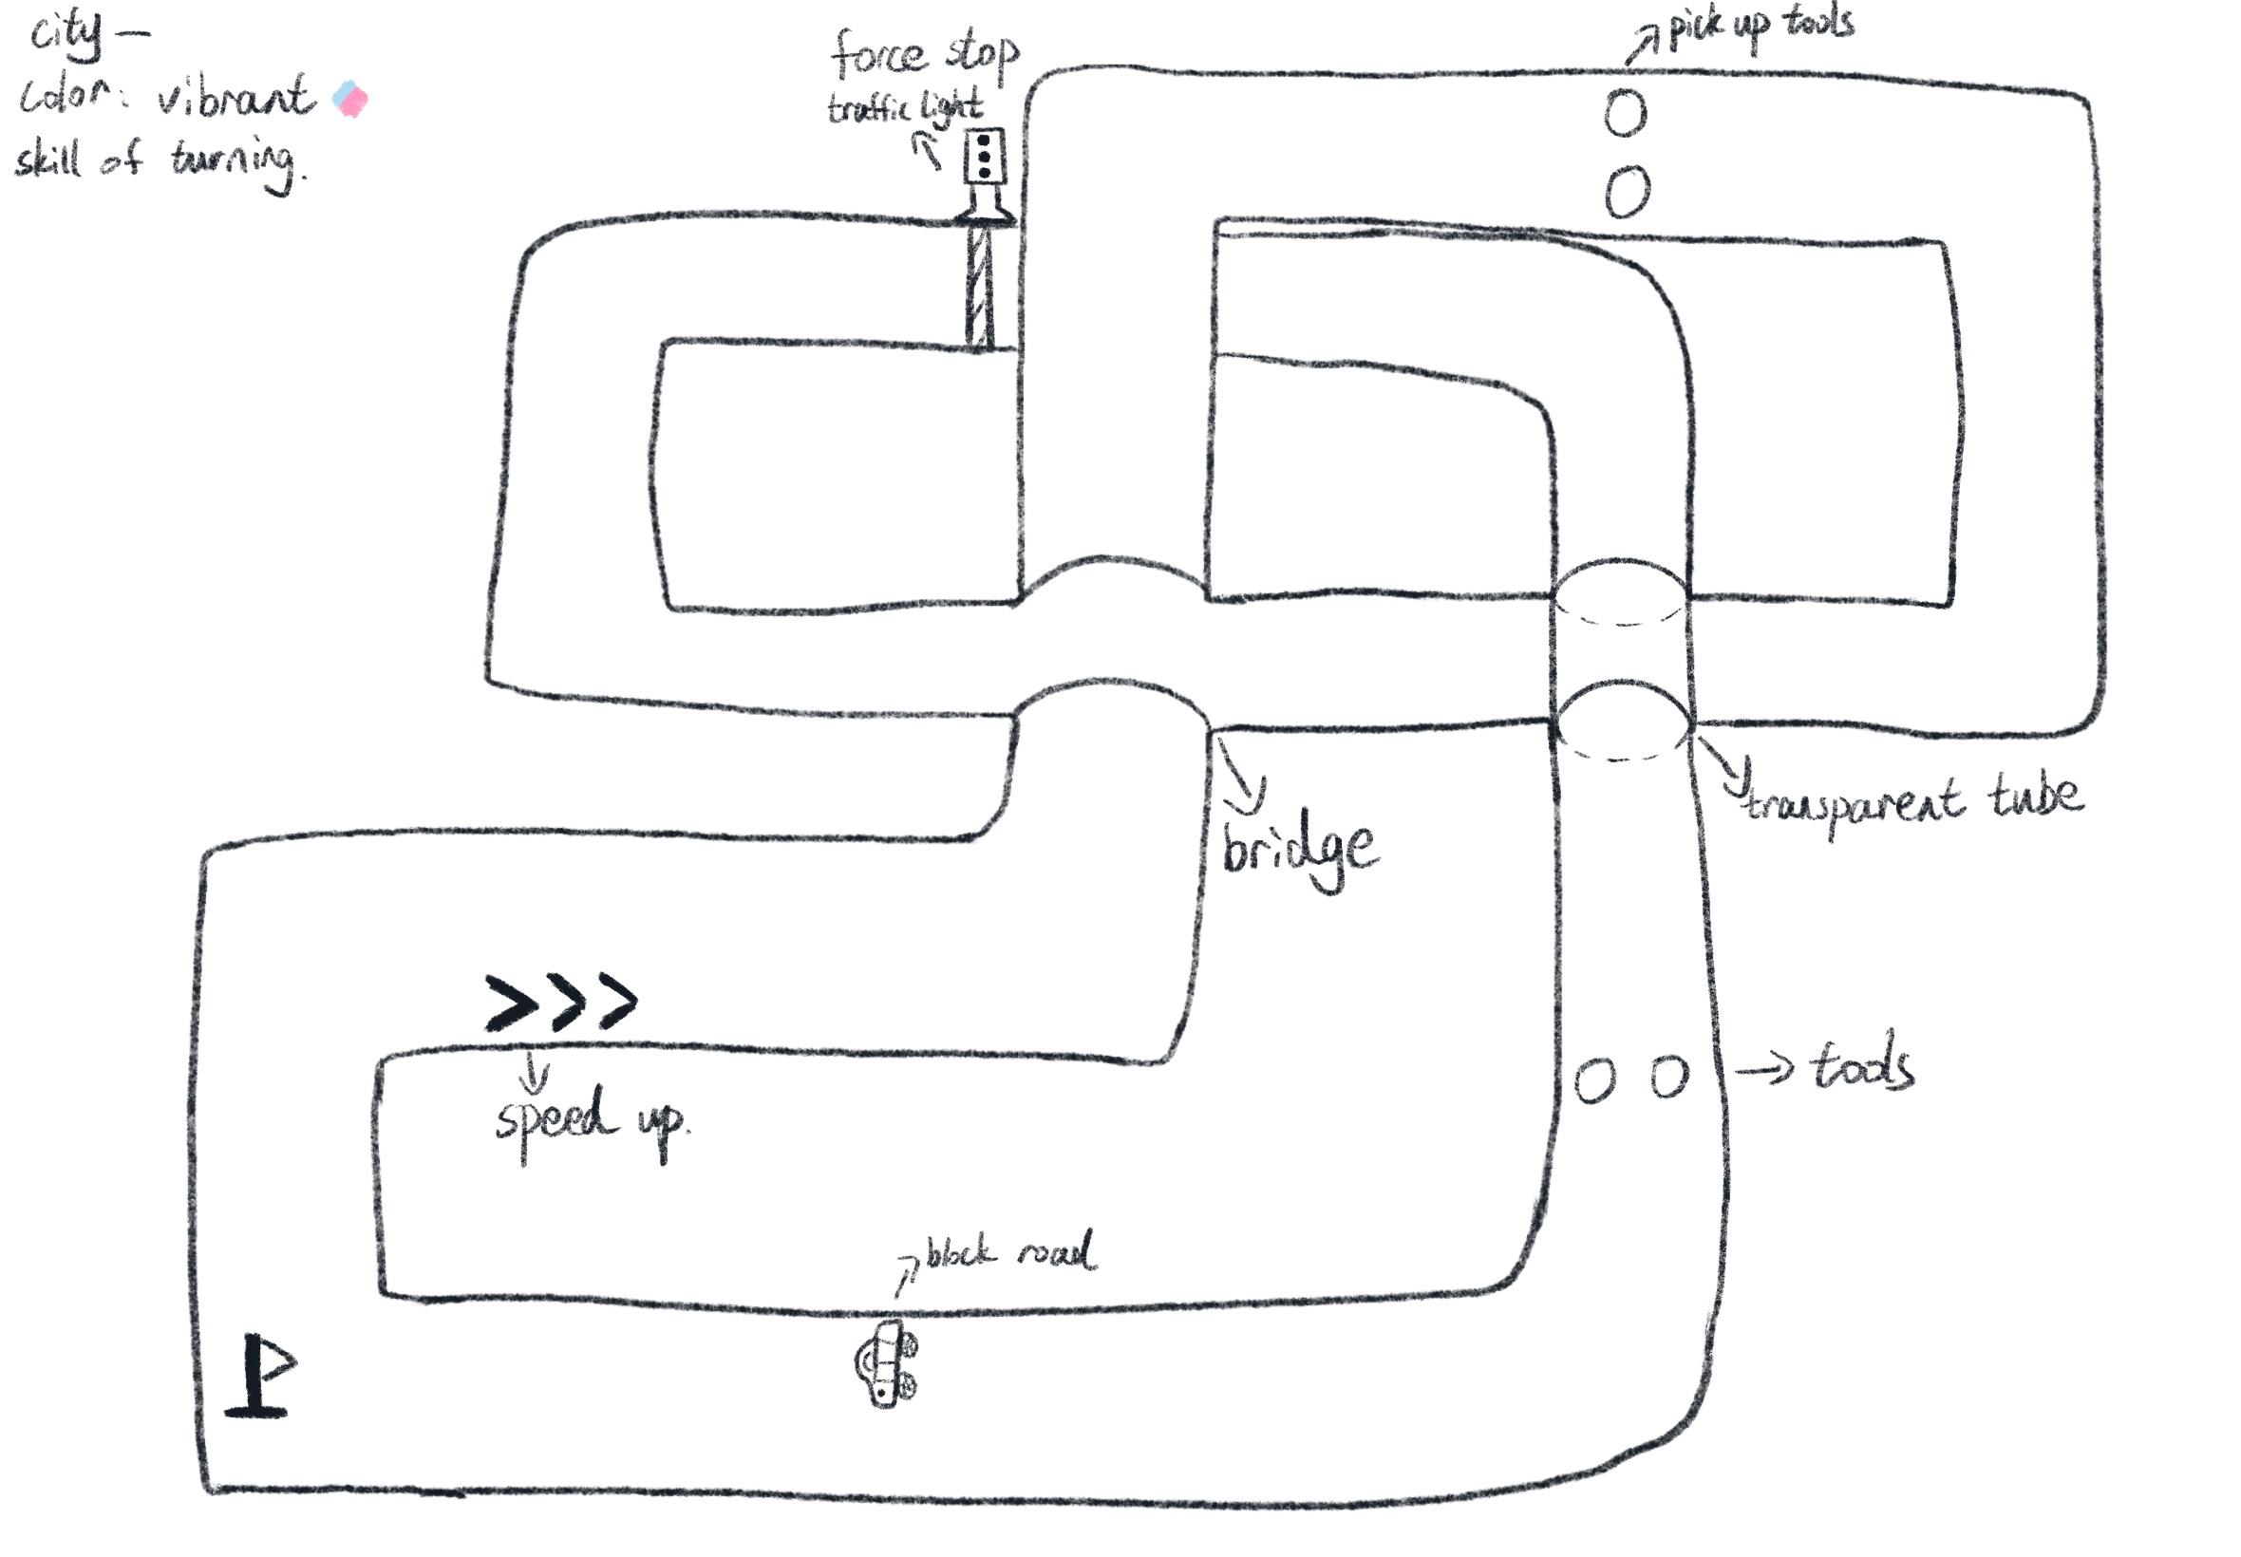
City Track Vibrant color Turning skill
Key design:
--Overlap roads --Pick up tools --Elements block road (city elements) --Traffic light (follow rules)

Slide 3
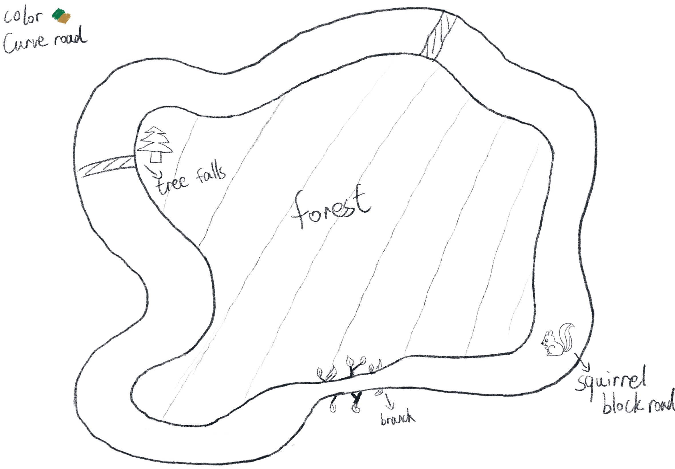
Forest Curve road skills
Key design:
--central forest --fallen trees --squirrel (forest animals) --tree branches (pass one by one)

Slide 4
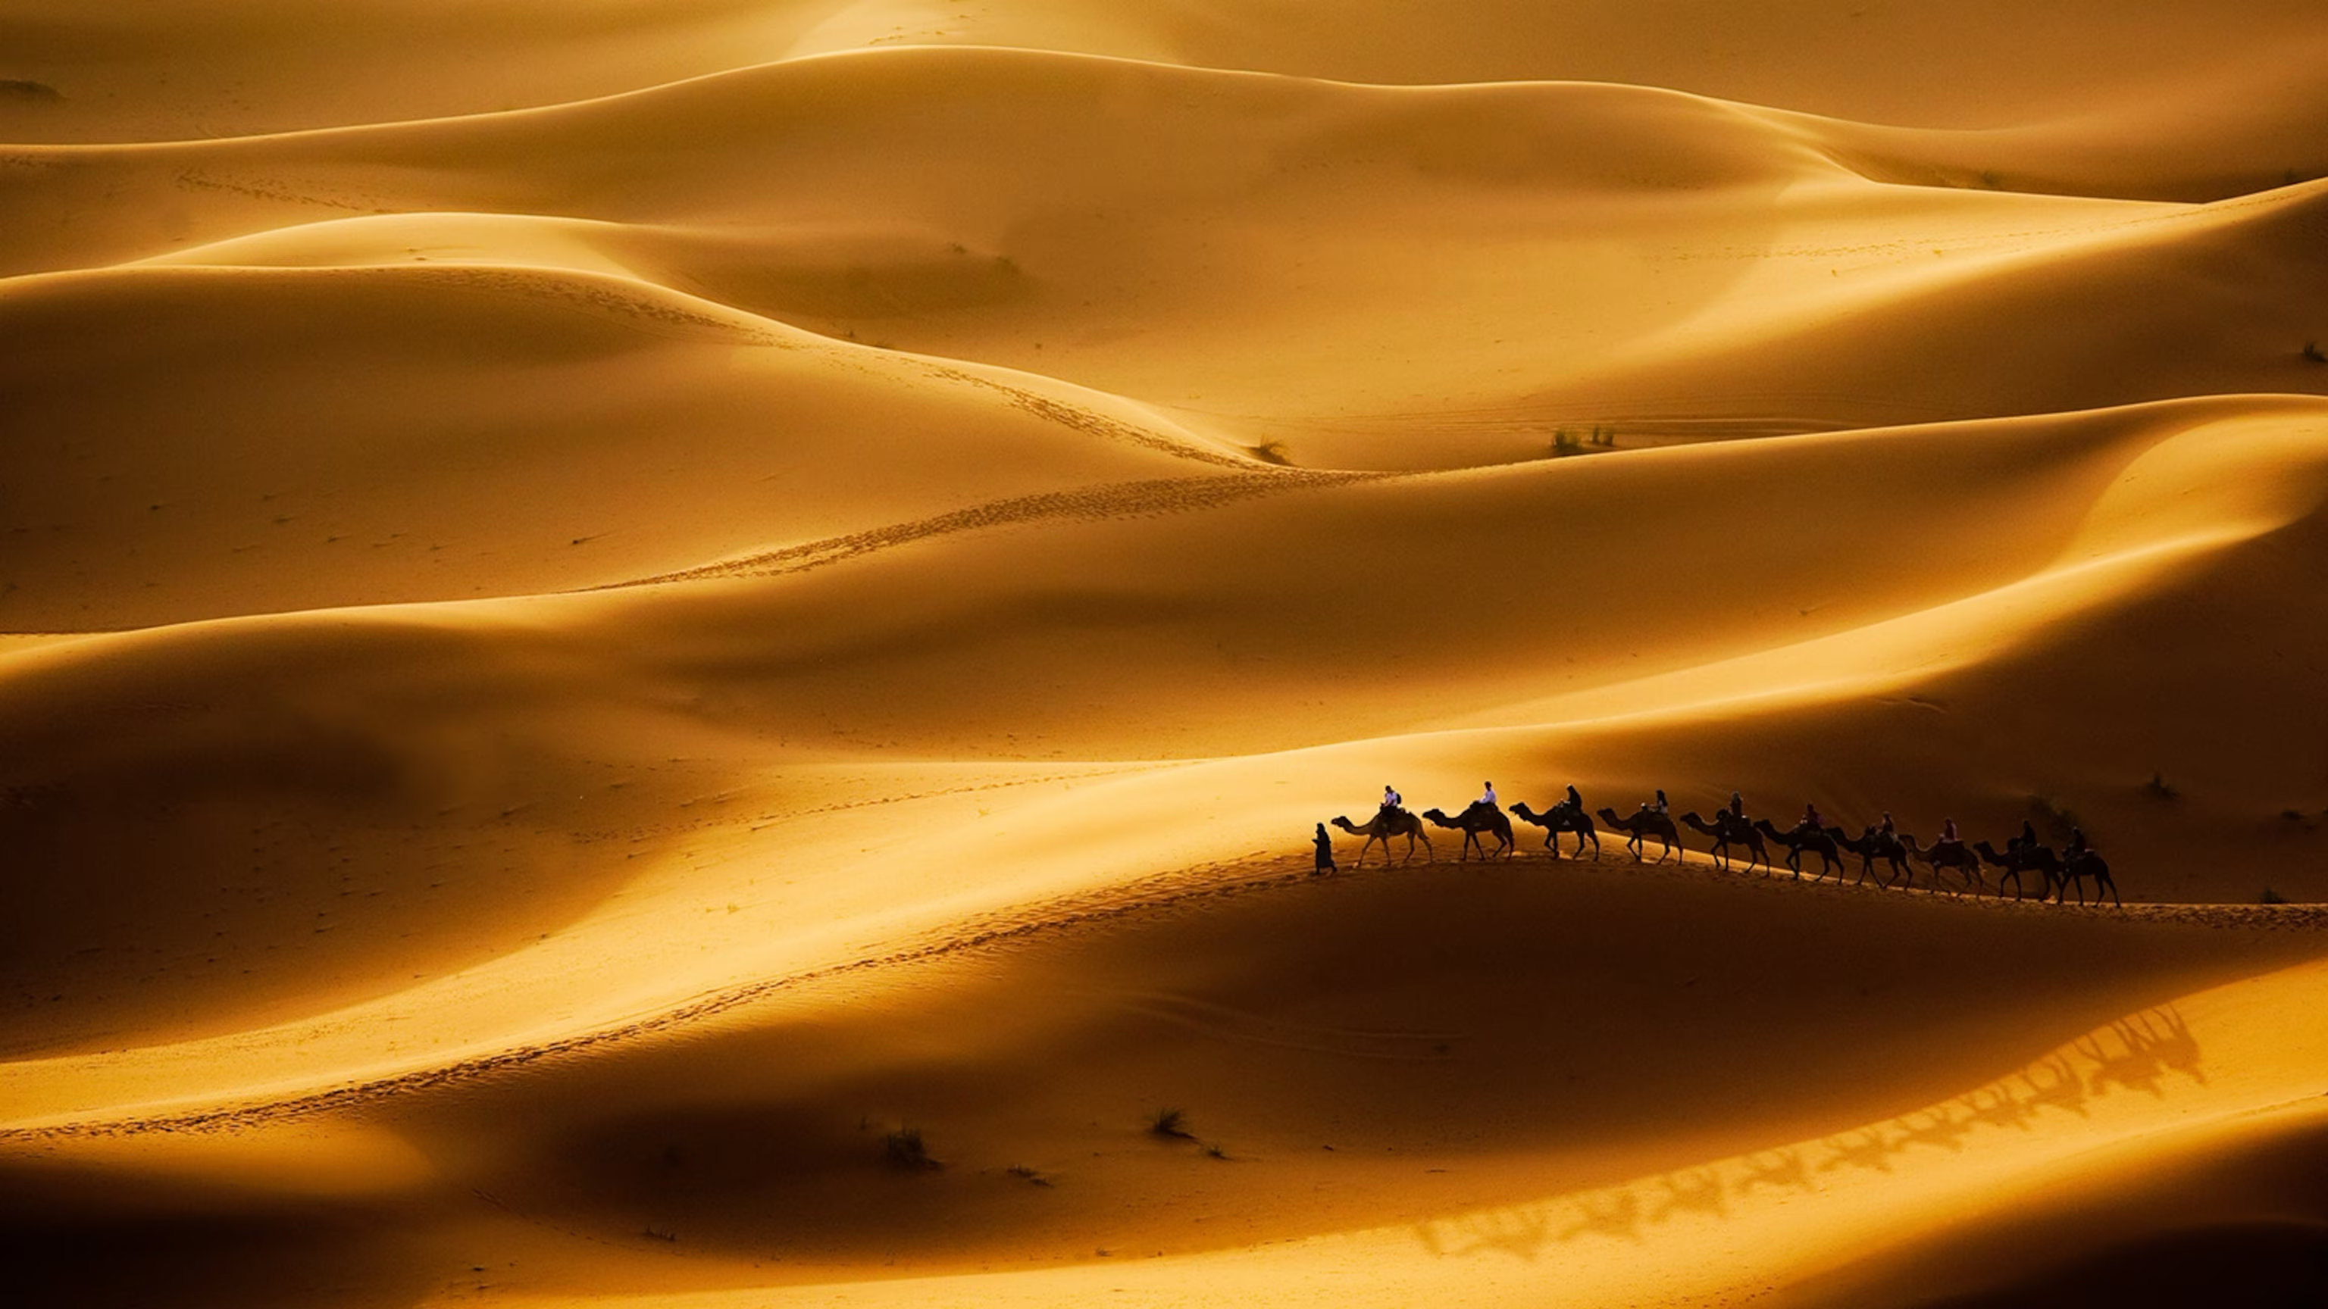
Desert
Reference

Slide 5
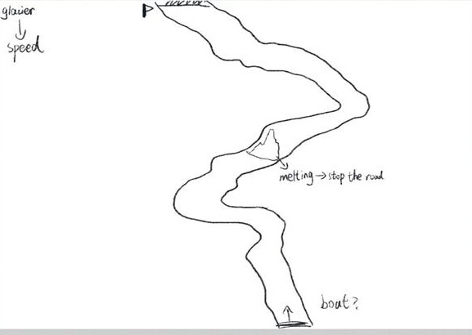
Glacier
Reference

Slide 6
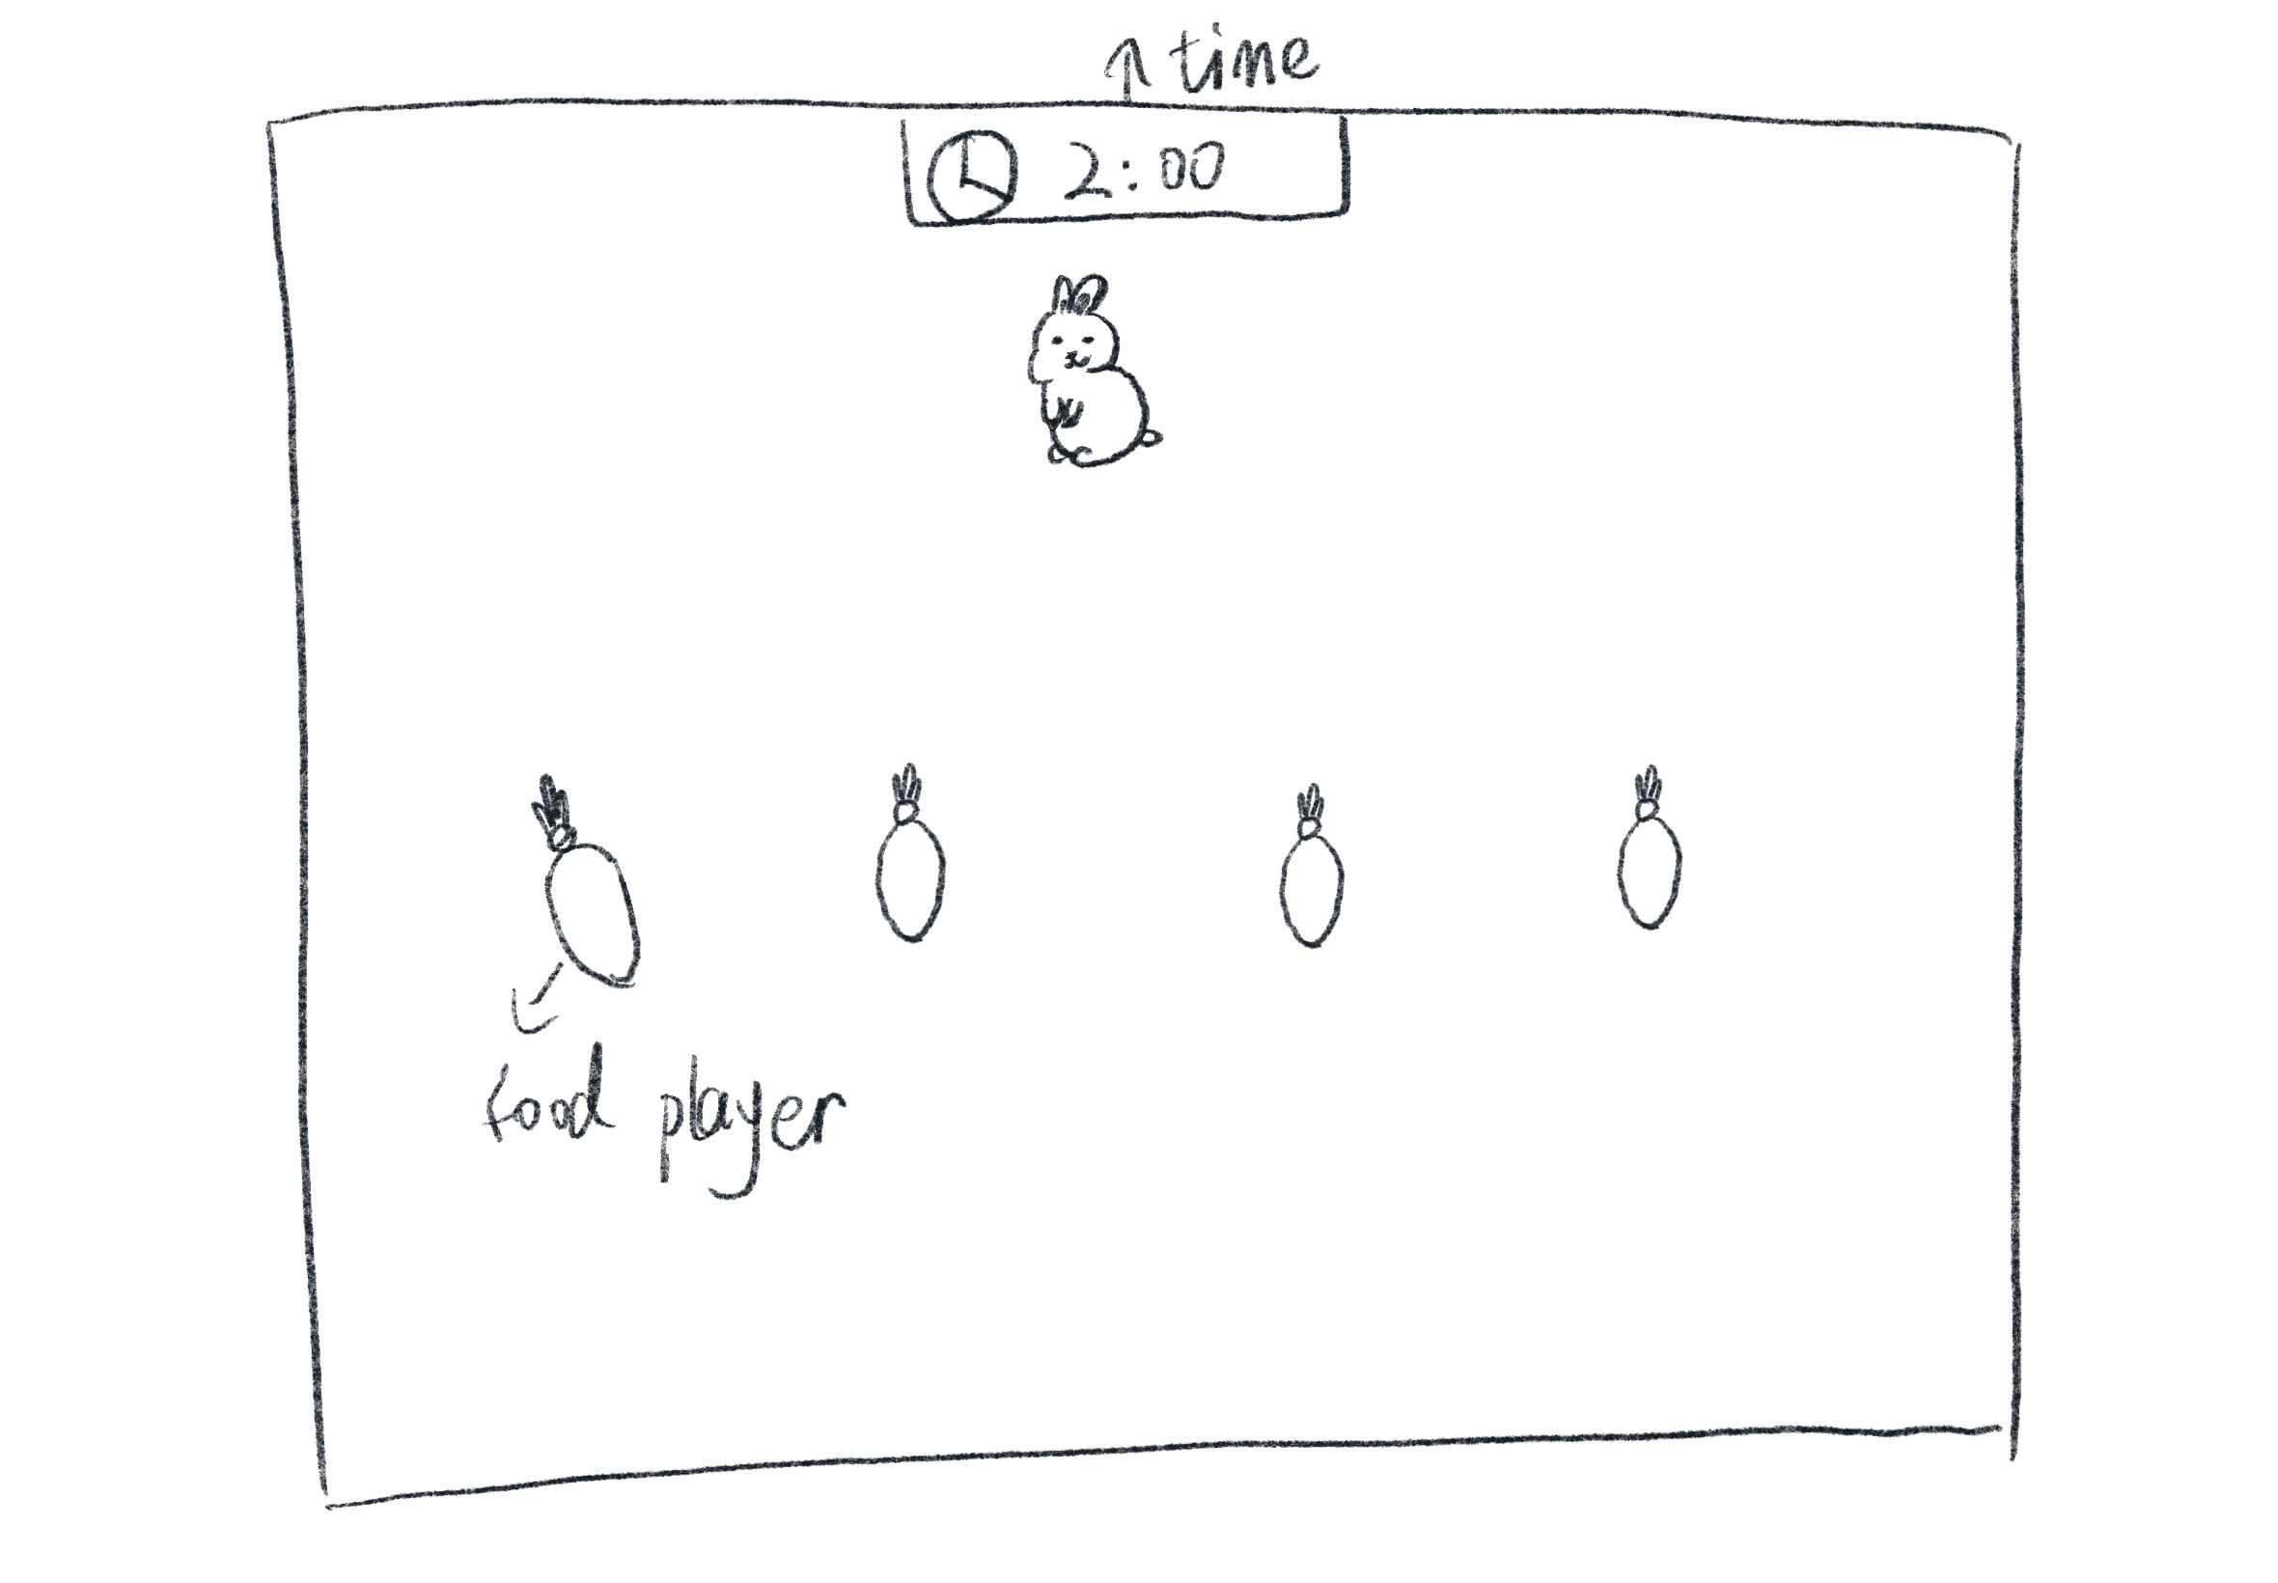
3rd Game
Animal food chain
For example, a rabbit and a carrot
They are randomly assigned as animal and food
The animal needs to chase the food and eat it

Slide 7
3rd Game
Animal bathing

